Slide 1







Playing with Tiny bit
Adventure car
Yahboom

Slide 2









Contents
Preparation
Learning goal
Search for blocks
Combine blocks
Experimental phenomena
Yahboom

Slide 3

Preparation
This course is mainly based on the accelerometer that comes with micro:bit.
When we rotate the micro:bit around the x-axis, that is, when rotating on the yoz plane, the degree of the rotation (picth) will be changed.
When we rotate the micro:bit around the y-axis, that is, when rotating on the xoz plane, the degree of the rotation (roll) will be changed.
When we rotate the micro:bit around the z-axis, that is, when rotating on the yoz plane, the degree of the rotation (yaw) will be changed.
In this experiment, we use the rotation angle to judge.
Yahboom

Slide 4
Preparation
Programming method:
Mode 1 online programming: First, we need to connect the micro:bit to the computer by USB cable. The computer will pop up a USB flash drive and click on the URL in the USB flash drive: http://microbit.org/ to enter the programming interface. Add the Yahboom package: https://github.com/YahboomTechnology/Tiny-bitLib to program.
Mode 2 offline programming: We need to open the offline programming software. After the installation is complete, enter the programming interface, click【New Project】, add Yahboom package: https://github.com/YahboomTechnology/Tiny-bitLib, you can program.
Yahboom

Slide 5
Learning goal
1.Learn how to use accelerometer graphically program building blocks
2.The function is realized by programming: Tiny-bit advances for one second, stops for one second, during the stop to detect whether the current position is flat, if it is flat, it will continue to advance, if it encounters a slope, it will back or rotate to leave the hillside and change the direction of advance.
Yahboom

Slide 6

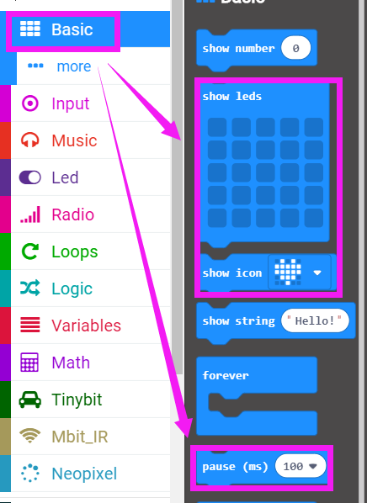
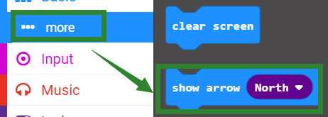
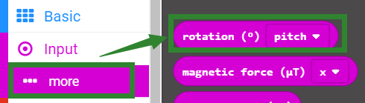
Search for block
The following is the location of the building blocks required for this programming.
Yahboom

Slide 7
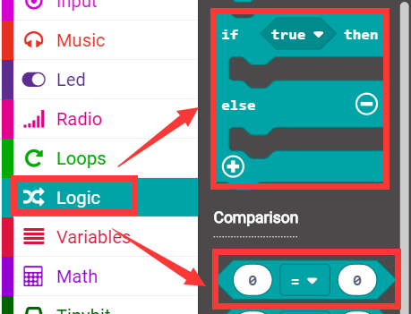
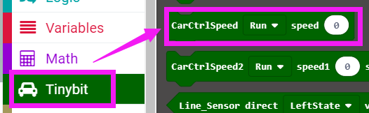
Search for block
Yahboom

Slide 8
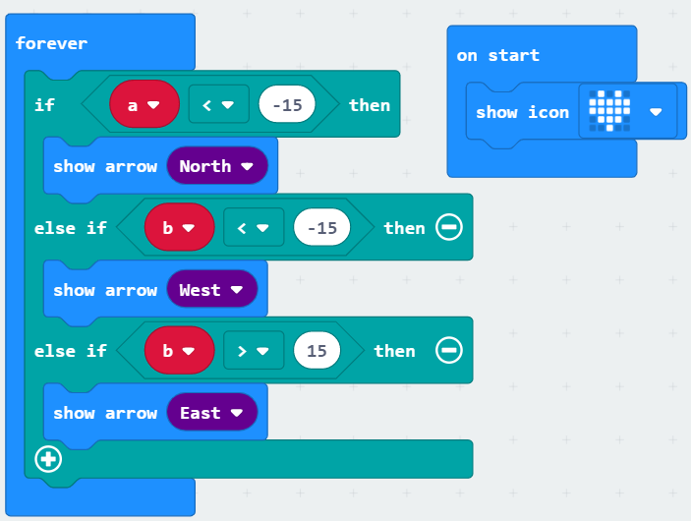
Combine block
The summary program is shown below:
Yahboom

Slide 9
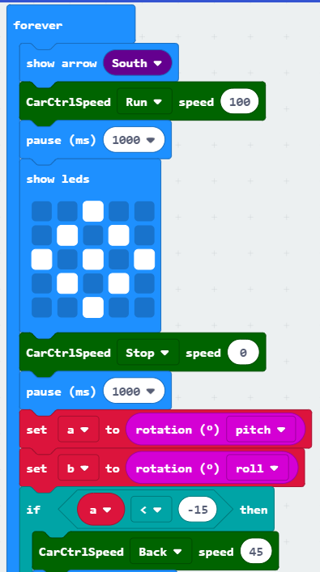
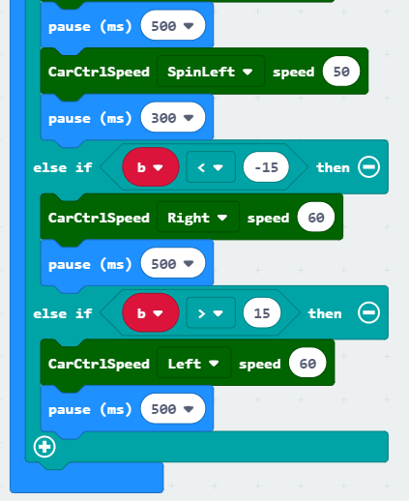
Combine block
Yahboom

Slide 10
Experimental phenomena
After the program is downloaded, open the power of the car. Tiny-bit will advance one second, stop one second, check if it is currently on the slope, and if it is flat, move on. If the slope is directly in front, Tiny-bit will back, then spin left to leave the hillside and look for the flat; if the slope is on the right, Tiny-bit turns left, leaves the hillside, looking for the flat; if the slope is on the left, Tiny-bit turn right, leave the hillside, look for the flat...
When moving forward, the micro:bit dot matrix displays the forward arrow.
When it is still, the micro:bit dot matrix display scattered points.
If the slope is directly in front, the micro:bit dot matrix displays the backward arrow;
if the slope is on the right side , the micro:bit dot matrix displays the arrow to the left;
if the slope is on the left side, the micro:bit dot matrix displays the arrow to the right.
Yahboom

Slide 11
Inspire Creativity Embrace Innovation
Thank you!!!

